Slide 1
Representing Uncertainty in Geospatial Visualizations
Matthew L. Sisk
GIS / Anthropology Librarian
Navari Family Center for Digital Scholarship
Eck Institute for Global Health

Slide 2
What is uncertainty?
“the state of being uncertain”
Anything that renders a measurement less than absolutely accurate
Measurement error
Measurement bias
Missing components
Ambiguously defined concepts
Geospatial uncertainty
Positional accuracy
Geometry choices
Model error terms
Different scales of measurement
Administrative differences

Slide 3
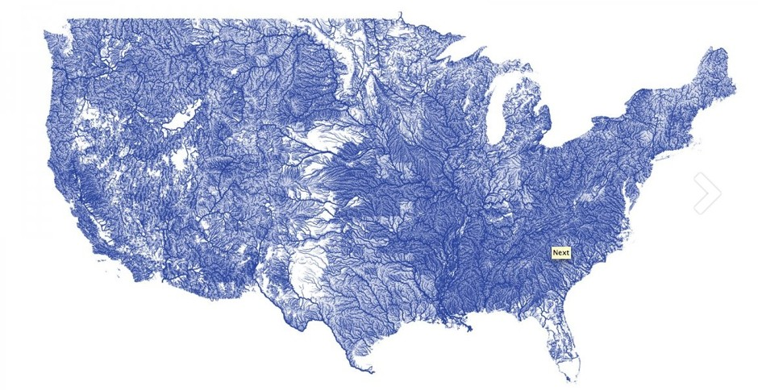

Slide 4
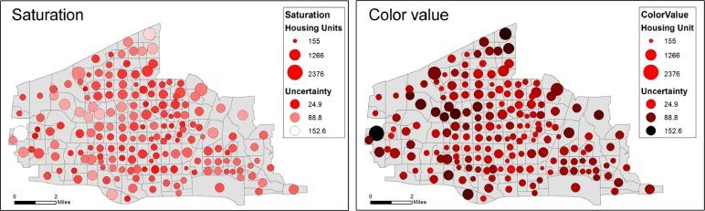
How do we represent uncertainty?
Positional uncertainty
Size or color of point locations represents the uncertainty of the location
GPS or geocoding error term
Fuzzyness / Opacity
Opacity is used to represent an error term
http://project-ukko.net/map.html
Uncertainty in statistical measures
e.g. American Community Survey

Slide 5
How do we teach people it is important?
Incorporate into early GIS workshops / guest lectures
Develop tools for instructors / independent learners to understand and effectively visualize the uncertainty in their data
Libguide / github page of examples and techniques in major geospatial software

